Slide 1
Data analyst-Practical
By : Anjela M. Andeo

Slide 2
Introduction
The dataset for analysis is obtained from AAR Healthcare and it contains information obtained from 1st January, 2017 to 30th June 2018. It contains infomation which 73001 rows and 24 columns of data

Slide 3
Steps:
Data wrangling
Here, we are going to look at the general properties associated with our dataset. For example checking for missing values, confirming the number of rows and columns in the dataset, checking for uniqueness etc.
Data cleaning
In this stage, we want to work on the outliers identified in our Data Wrangling stage.
Exploratory data analysis
In this stage, we are going to pose questions as identified after our dataset has been cleaned and answer each question with visuals. The visuals will basically be a relationship between two variables.

Slide 4
Presentations:
In this stage, we showcase all the graph that were obtained from the various questions we obtained from the exploratory phase.

Slide 5
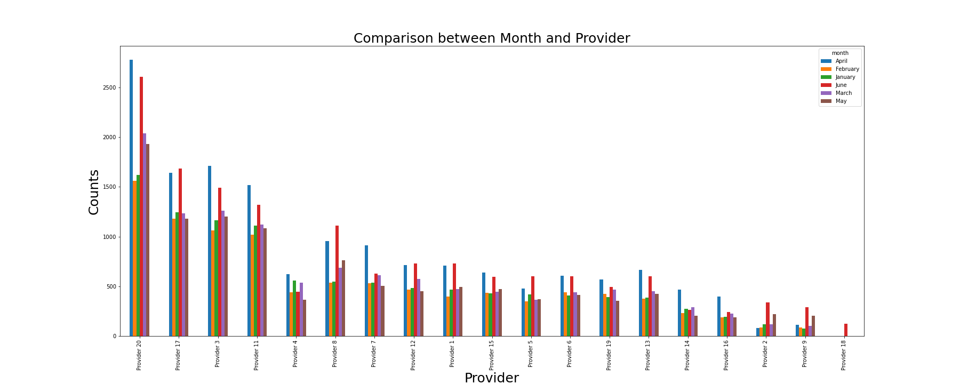
Plot 1: Question 1: Month utilization per provider As observed, provider 20 had the highest number of counts and provider 18 had the least

Slide 6
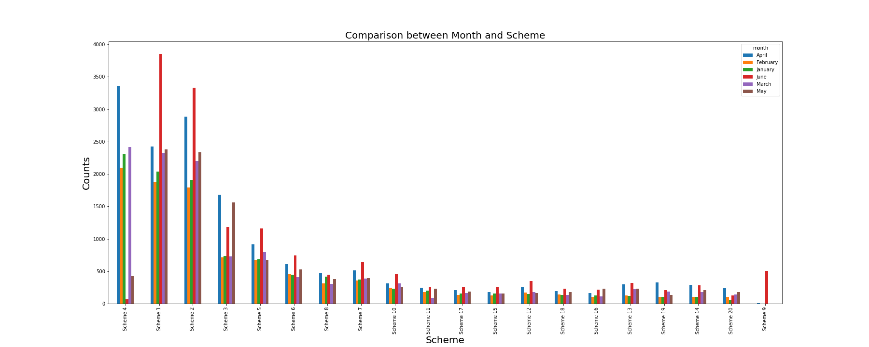
Plot 2: Scheme utilization trends Scheme 1 recorded the highest number of counts in June, scheme 4 recorded the highest count in April and scheme 4 recorded the lowest in all the months

Slide 7
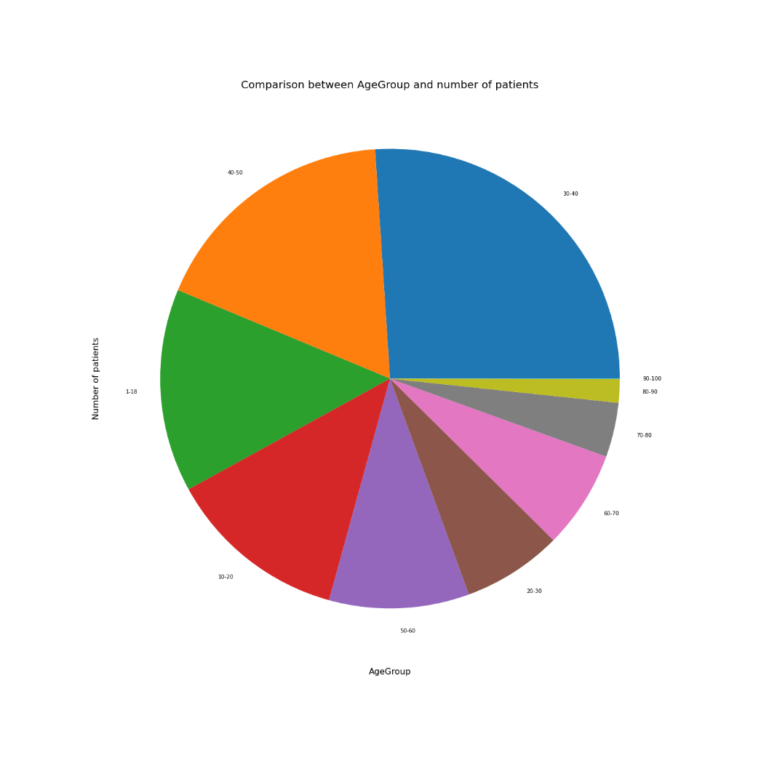
Plot 3: Monthly visit trends children vs adults Adults between age 30 to 50 recorded the highest count while children between age 1 to 20 also recorded highest count. The rest, most especially from age 60 to 100 had less turn up

Slide 8
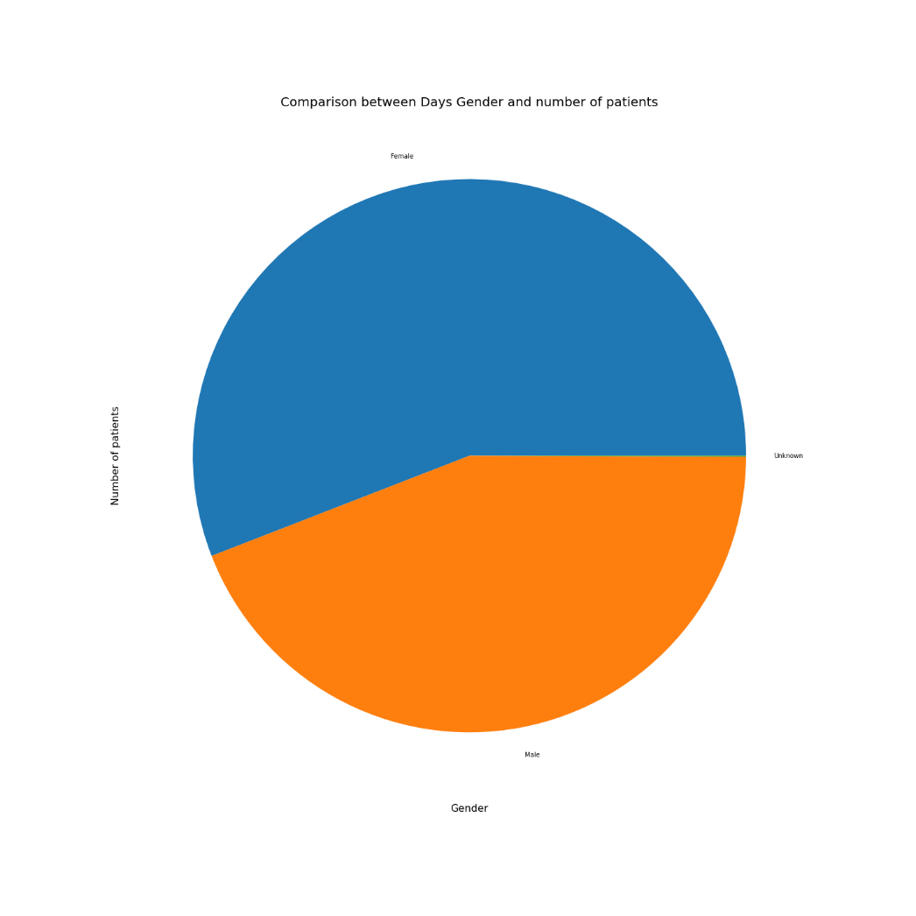
Plot 4: Does gender affect patients who show up Females recorded the highest turn up compared to males

Slide 9
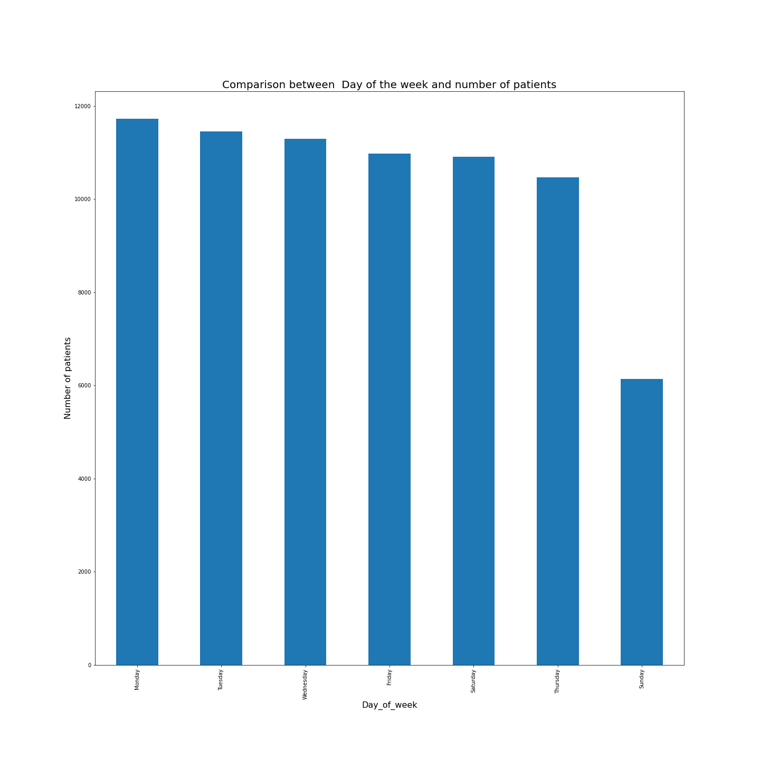
Plot 5: Checking the day of the week for the visit Patients show up highly on Mondays compared to Sundays

Slide 10
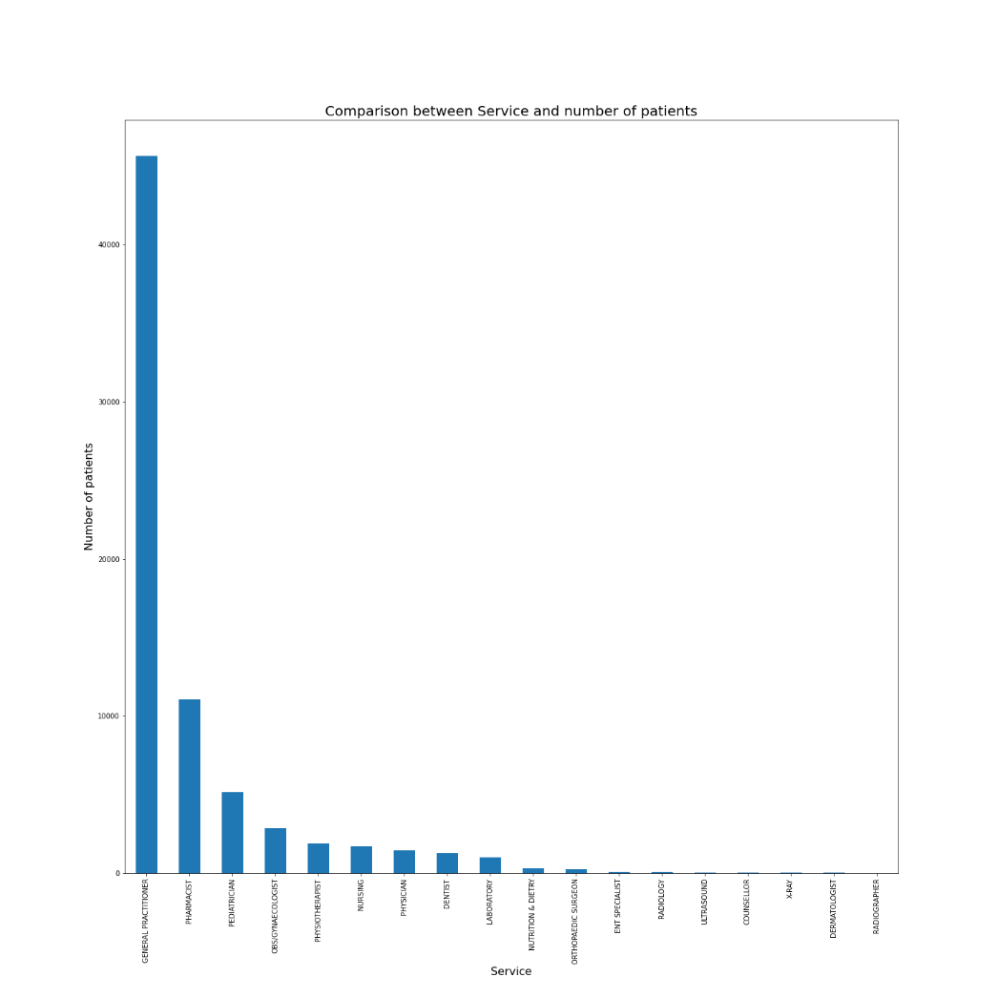
Plot 6: Comparison between service and the number of patients Patients who turned up for general practioner were higher in number compared to the rest.

Slide 11
Conclusion
It can be concluded that age, gender, service, the day of the week and the average cost per visit are important factors to check to showcase the probability of patients turning up for services at AAR Hospital.

